Slide 1



Target Ecommerce Data Analytics Project
From Raw Data to Actionable Insights
By: Umar Mushtaq
Supervised by: Dr Nayer (Jamia Hamdard Professor)
This presentation explores a comprehensive sales analytics solution for Target, leveraging MySQL, Python, and Power BI to uncover customer behavior, revenue trends, and operational insights—transforming raw data into actionable strategies for growth.

Slide 2

Project Overview
Data Pipeline
Key Insights
Power BI Dashboard
Recommendations
Agenda

Slide 3

Let’s Understand Ecommerce
Ecommerce
E-commerce means buying/selling online
It's shopping or selling products through websites or apps instead of physical stores.
What it uses?
It uses digital tools to work smoothly Like mobile payments, instant transactions, automatic stock tracking, and barcode scanners.
Different from E-business
E-commerce = just transactions of goods & services (like Target or Amazon purchases).
E-business = everything about running an online company (including marketing, websites, etc.)

Slide 4
Target’s Ecommerce
Target Ecommerce Company
Target is a globally recognized brand and a leading retailer in the United States, known for offering exceptional value, inspiration, innovation, and a unique shopping experience.
What we do here?
We will analyse the dataset that focuses on Target's operations in Brazil, covering 100,000 orders placed between 2016 and 2018. It includes detailed information on order status, pricing, payment and shipping performance, customer locations, product attributes, and customer reviews.

Slide 5
Project Overview
Problem
Target has huge sales data but lacks clear insights into customer behavior, regional trends, and revenue drivers.
Impact
Without proper analysis, decisions are delayed—causing missed opportunities in inventory, marketing, and growth.
Solution
Using MySQL, Python, and Power BI, this project turns raw data into actionable insights to boost demand forecasting and profitability.

Slide 6
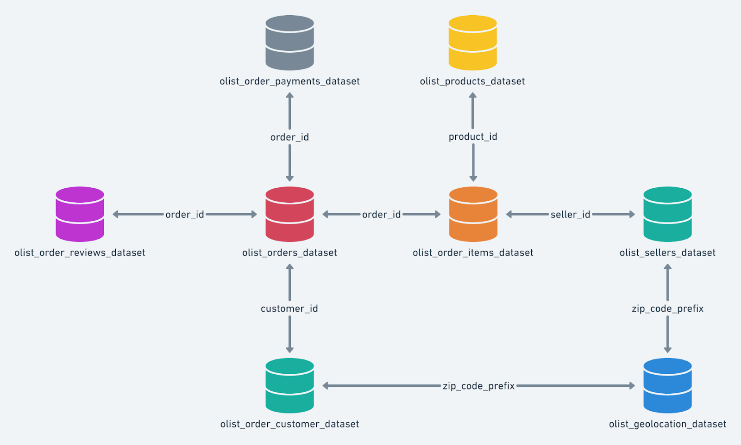
Target’s
Dataset
Schema

Slide 7
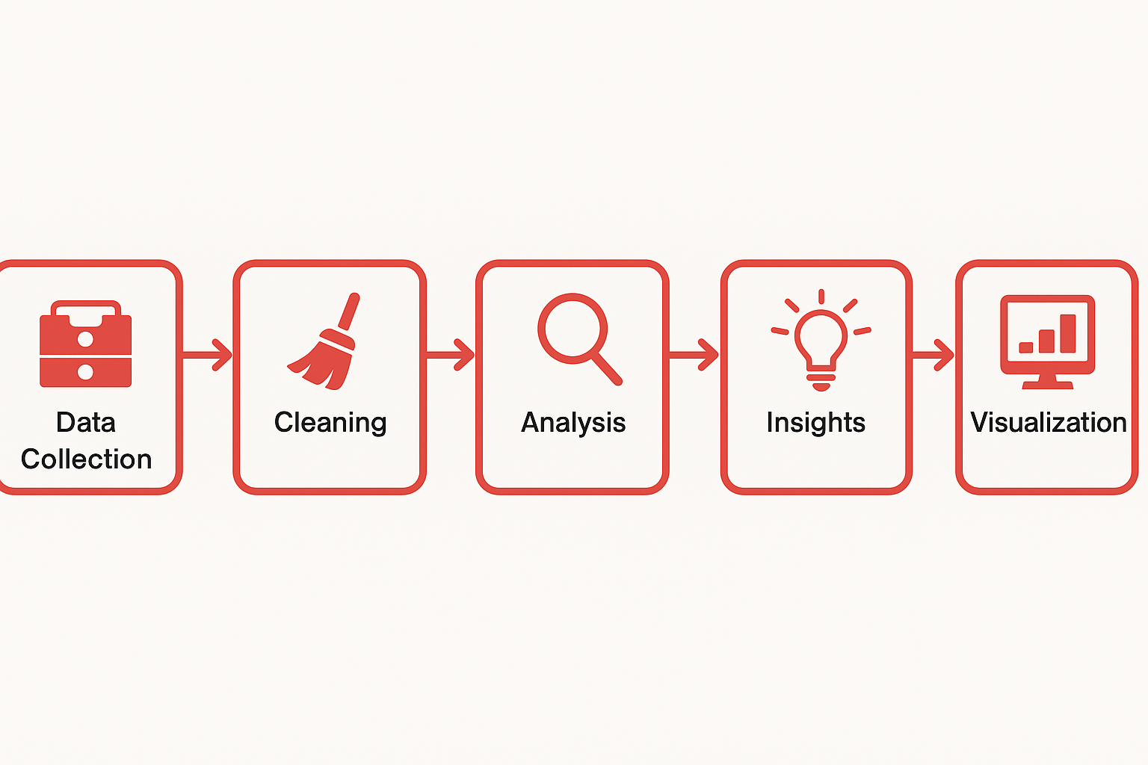
Data Pipeline

Slide 8



Tools Used
MySQL
Stored and queried transactional data.
Python
Cleaned data and calculated advanced
metrics (Pandas,Matplotlib,Seaborn)
Power BI
Built interactive dashboards for stakeholders

Slide 9
Key Insights
Some KPI’s
🧍 99.4K Unique Customers
🧾 49.4% Used Installments
🛒 3,095 Sellers
🌐 27 States Covered
📦 74 Product Categories
📈 Price-Demand Correlation: -0.106 (Weak inverse
relationship)

Slide 10
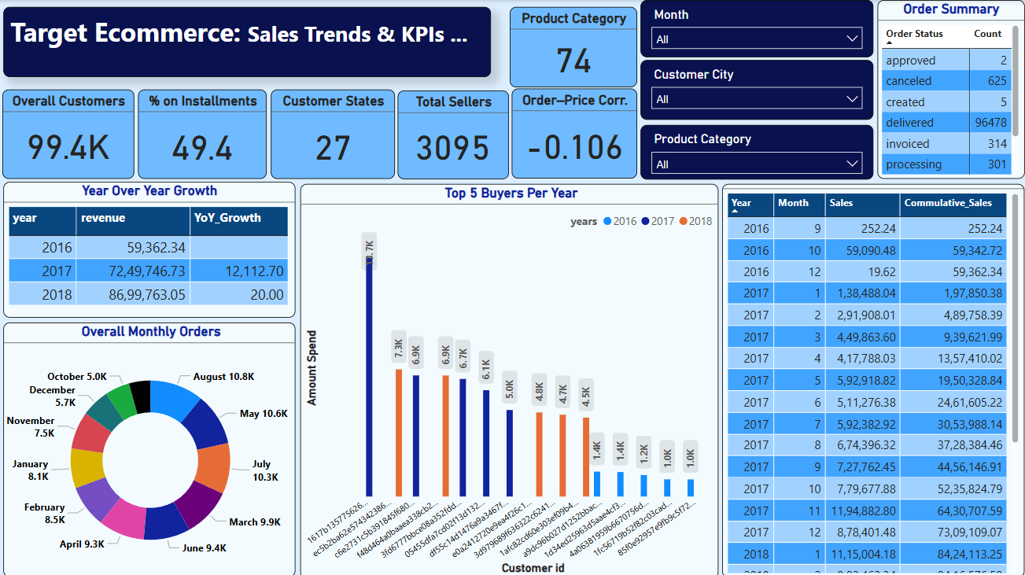
Key Insights

Slide 11
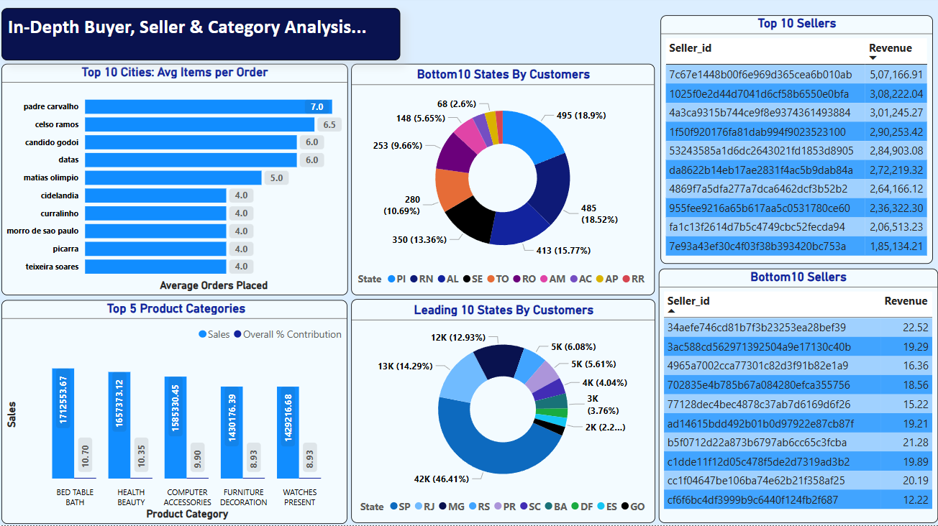
Key Insights

Slide 12
Recommendations
Based on the data analysis, the following actions are recommended:
Increase inventory in top-performing categories to maximize revenue.
Offer loyalty bonuses to top-spending customers to boost retention.
Target high-order-volume cities with localized promotions.
Expand operations in states with growing customer bases.
Encourage installment-based payments to increase affordability.
Highlight best-selling products more prominently in the storefront.
Analyze pricing strategies for low-performing categories.
Streamline seller onboarding in top-performing regions.
Offer bundled discounts on categories with low average order values.

Slide 13
Recommendations
Improve delivery times in high-order regions to enhance satisfaction.
Use customer lifetime value (CLV) to segment and market to key audiences.
Promote products with high correlation to multiple purchases.
Offer limited-time deals during peak months (based on order frequency).
Utilize abandoned cart reminders to improve conversion.
Track retention rates monthly and launch re-engagement campaigns accordingly.
etc

